Slide 1

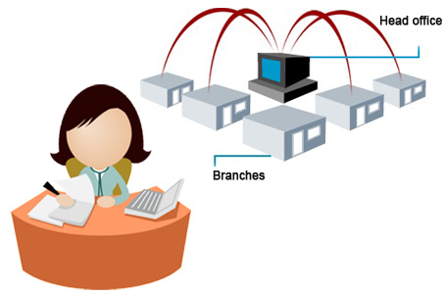
OFFICE MANAGEMENT SYSTEM
GROUP 1-P

Slide 2


Group Members
1.Suwendra Gunawardhana
2.Ayodhya Manewa.
3.Nadeeshani Kaushalya.
4.Sarangika Ethugala.
5.Matheews Sathurshan.
6.Sangaranathan Sangalral
7.Nivethana Shanmugarathnam
Supervisor :- Dr.E.Y.A.Chales
Instructor :- :- Miss Nirthika R.
Miss T.Bamini

Slide 3


Introduction
Office management system is a technique of planning,organizing,coordinating and controlling office activities with a view to achieve business objectives and is concerned with efficient and effective perfomance of the office work.

Slide 4

REQUIREMENTS
Employees : Add Employee Clients : Add Client
Employee Listing List Client
Upload
Projects : Add Project Teams : Add team
List Project Team Listing
Assign Projects
Project Assignment Listing
Roles : Add Roles Leaves : Apply leaves
Role Listing My leave list
Add leave type
Leave type listing
Total leave listing

Slide 5
Expense: Add expense Awards: Add Award
Expense Listing Award listing
Awardees
Awardees listing
Promotions: Promote Training: Add training program
Promotion listing Program listings
Training invite
Invitation listings
Holiday: Add holiday
Holding listings Company policies:
Download Forms:
Attendance: Excel file upload.
Meeting invitation: Save the time schedule of the meeting.
Bank account: Table is auto generate but admin can edit .

Slide 6

OBJECTIVES
Our objectives of this office management system are smooth flow of work,minimize risk, maintain safety and security,provides facilities to employees in the institution,effective supervision and control.
So this system ensures that office runs to maximum efficiency which will ensure greatest profitability.

Slide 7

DEVELOPMENT METHODOLOGY
.
Laravel Framework(version 5.2)
HTML5/CSS
( JavaScript )
JQuery
Bootstrap

Slide 8

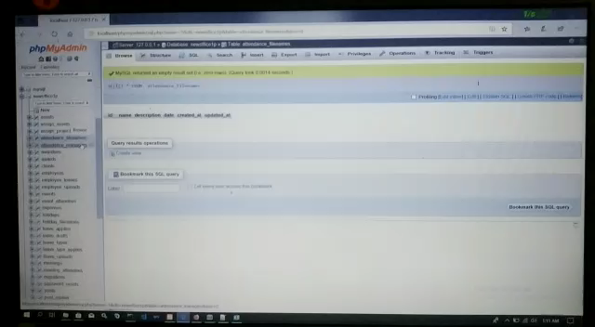

Slide 9


s

